Slide 1


NCAT Hackathon 2025
Breaking Medical Information Barriers by Simplifying Health for Patients
Medtronic Team: Abaas Kilas, Shakeyva Graff, Patrick Ogunbufunmi
November 2025

Slide 2
Problem Statement
Patients with implantable cardiac devices often see complex medical reports, unknown terminology, or alerts they struggle to interpret.
Your challenge is to design a website or mobile app for patients to simplify medical information, particularly heart failure, so they can clearly understand their health and feel more connected to their care
Core Functionalities
Bonus/Optional Functionalities
Secure Login and Logout System for Patients
Upload or Input Capability (e.g. PDFs, text entry)
Medical Term Recognition
  Utilize WebMD, Harvard Health, etc
  Maintain a dictionary or lookup method for recognition
A Medical Translation Engine
  Likely incorporates AI
  Structured output (e.g., “Term/Meaning/Why it Matters”)
Simple Accessibility & Design
  Simple layout, readable fonts, clear navigation (consider older patient demographics)
A Chatbot or Voice Assistant
Multilingual Support
A Lightweight or Offline Mode
  Use without internet, emphasis on design efficiency
Gamification or Learning System
  Quiz patients to expand medical knowledge, use of animations

Slide 3
Evaluation/Rubric
Teams will be judged on functionality, implementation, and creativity. The goal is to see how effectively your solution bridges the gap between clinical data and patient understanding
Teams are encouraged to push innovation beyond the core requirements. Expand and include as much as your team wishes, the more your solution can do for patients the better
Core Functionalities | Design & Implementation | Demonstration/Pitch | Bonus/Optional Functionalities
40% | 40% | 20% | 15% per
Meets the challenge requirements such as uploading, translating, displaying medical info clearly | Intuitive, accessible, and visually clear interface. Scalability, performance of the system, security/privacy considerations were made. Teams show basic AI/NLP use in their solution | Clear demo of solution. Creativity in presentation or storytelling. Teams should consider ethical/safety/legal concerns. Explanation/summary of tech stack. Can be recording or done live | Additional features like chatbot/voice integration, multilingual support, offline mode, and trivia

Slide 4
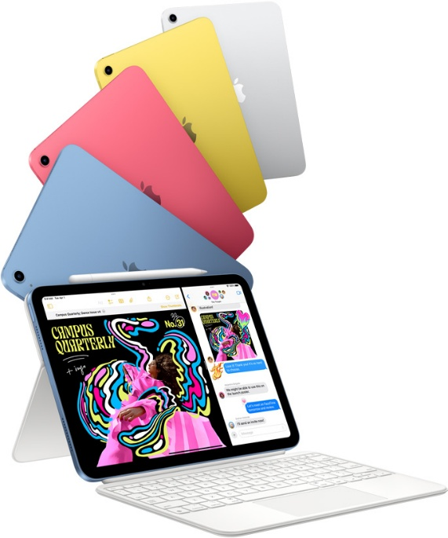
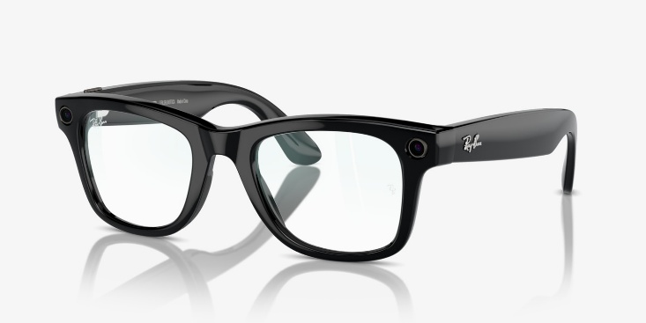
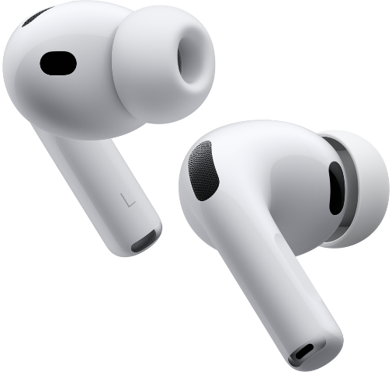
Prizes
1st Place | 2nd Place | 3rd Place

